Slide 1
VF76 - EOL Process
The VF76 End of line (EOL) process of module program and drum brake test machine for Spartan’s Charlotte, Michigan plant.
Step 1
EOL Program
ECM
DCU
Mimamori
Step 2
EOL Test machine
(Front Axle Test)
Step 3
EOL Test machine
(Rear Axle Test)

Slide 2
VF76 - EOL Program (Flash) – Step 1
EOL equipment is to program the following modules:
  ECM
    Check ECM Part number
    Check Calibration Part number
    VIN to be programmed
    ESN to be programmed
    Vehicle speed value revised based on GVW and Tire size
    Speed limit to be cleared
  DCU
    Check DCU part number
    Check calibration Part number
    VIN to be programmed

Slide 3
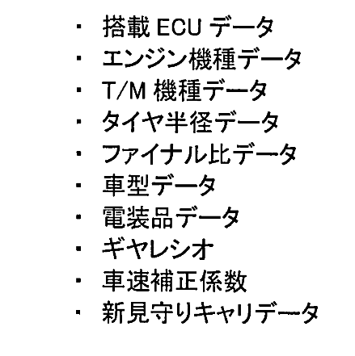
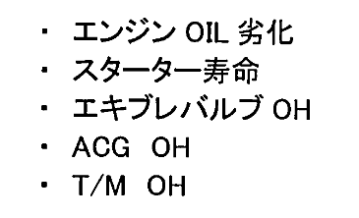
VF76 - EOL Program (Flash) – Step 1
EOL equipment is to program the following modules:
  Mimamori
    Check Mimamori Part number
    VIN to be programmed
■Mimamori data
･Installed ECU data
･Engine model data
･T/M model data
･Tire radius data
・Final ratio data
・Vehicle type data
・Electrical component data
・Final drive gear ratio data
・Vehicle speed correction coefficient
・New mimamori calibration data
■Maintenance data
・Deterioration of Engine Oil
・Starter life
・Exhaust valve OH
・ACG OH
・T/M OH

Slide 4
VF76 - EOL Front axle test – Step 2
EOL brake drum test equipment is to test the following for front axle:
  Test Brake force
  ABS Test

Slide 5
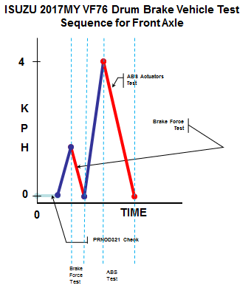
VF76 - EOL Front axle test – Step 2

Slide 6
VF76 - EOL Rear axle test – Step 3
EOL brake drum test equipment is to test the following for rear axle:
  Speed Meter test (40 kph) – MAF Sensor learn
  Brake force test
  ABS Test
  AT inspection (TCM)
    Check DTC
    Clear DTC
  ECM inspection
    Check DTC
    Clear DTC
  DCU inspection
    Check DTC
    Clear DTC
  Mimamori inspection
    Check DTC
    Clear DTC

Slide 7
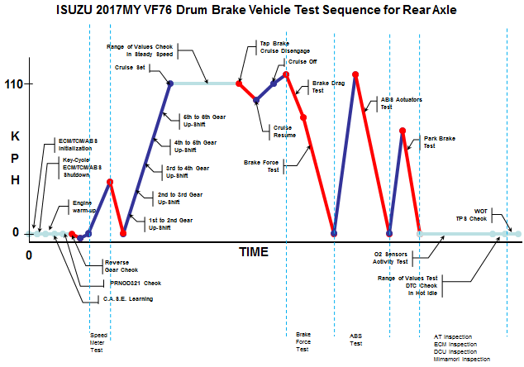
VF76 - EOL Rear axle test – Step 3

